Slide 1
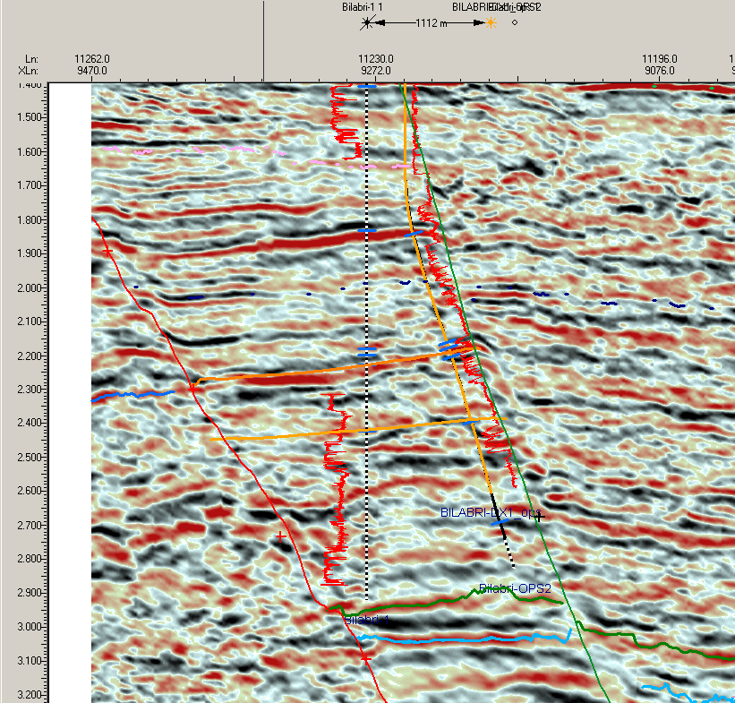
Morning report 19 jan 2006, MWD,
Gold is actual, black is planned.
LGS, smoothed
GWC, 2717 tvdss, flatspot!!
DWS-b

Slide 2
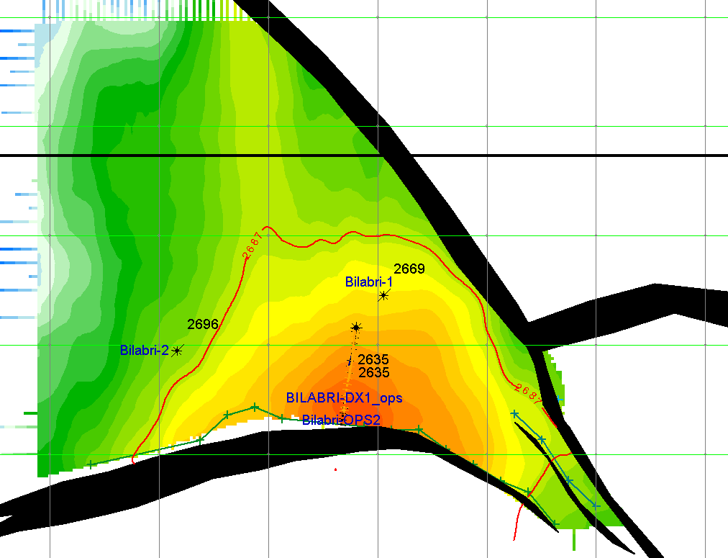
LGS_smoothed map without seismic artefacts (educated guess!!)
Area: 5.0 km²
Properties:
N/G: 0.9 , Por: 0.25 , Sw: 0.2 , Bg: 250
Thickness of sand: 10 m
Volumes: 80 Bcf

Slide 3
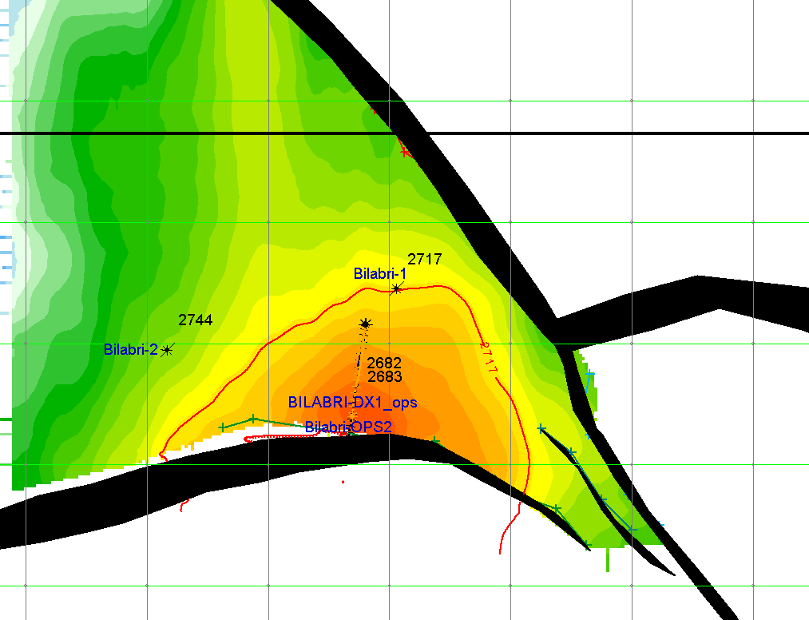
DWS-a map → shifted from the LGS-map
Area: 2.5 km²
Properties:
N/G: 0.95 , Por: 0.25 , Sw: 0.15 , Bg: 250
Volumes: 80 Bcf

Slide 4
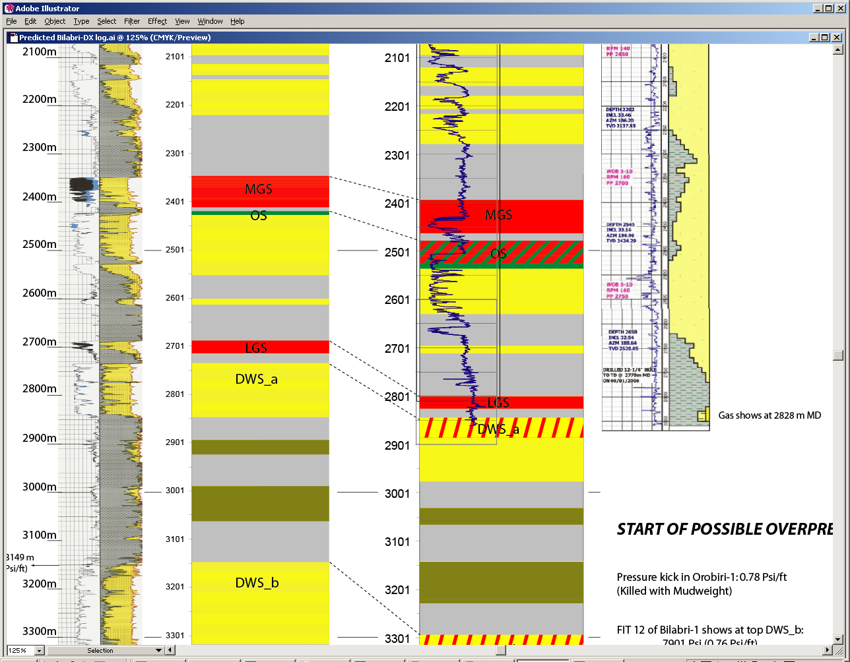
Gamma- ray of versus Prediction Bilabri-DX1
Bilabri-1 (MD)
Bilabri-DX1 (MD)

